Slide 1
Tidyquant Assignment
Point On Sale System
Retail-Selling Watches across multiple store and Location
By
Harshit Shukla

Slide 2
Various Steps
1:- Importing Libraries and Loading Data
2:- Data Cleaning and Prepossessing
3:- Merging data
5:- Exploratory Data Analysis
6:- Using K- Means clustering on each Brand

Slide 3
Various Libraries Used
import pandas as pd
import numpy as np
import matplotlib.pyplot as plt
Import seaborn as sns
from sklearn.cluster import KMeans
import pandas as pd
from sklearn.preprocessing import MinMaxScaler
from matplotlib import pyplot as plt
%matplotlib inline

Slide 4
Exploratory Data Analysis
pairs plot builds on two basic figures, the histogram and the scatter plot. The histogram on the diagonal allows us to see the distribution of a single variable while the scatter plots on the upper and lower triangles show the relationship (or lack thereof) between two variables

Slide 5
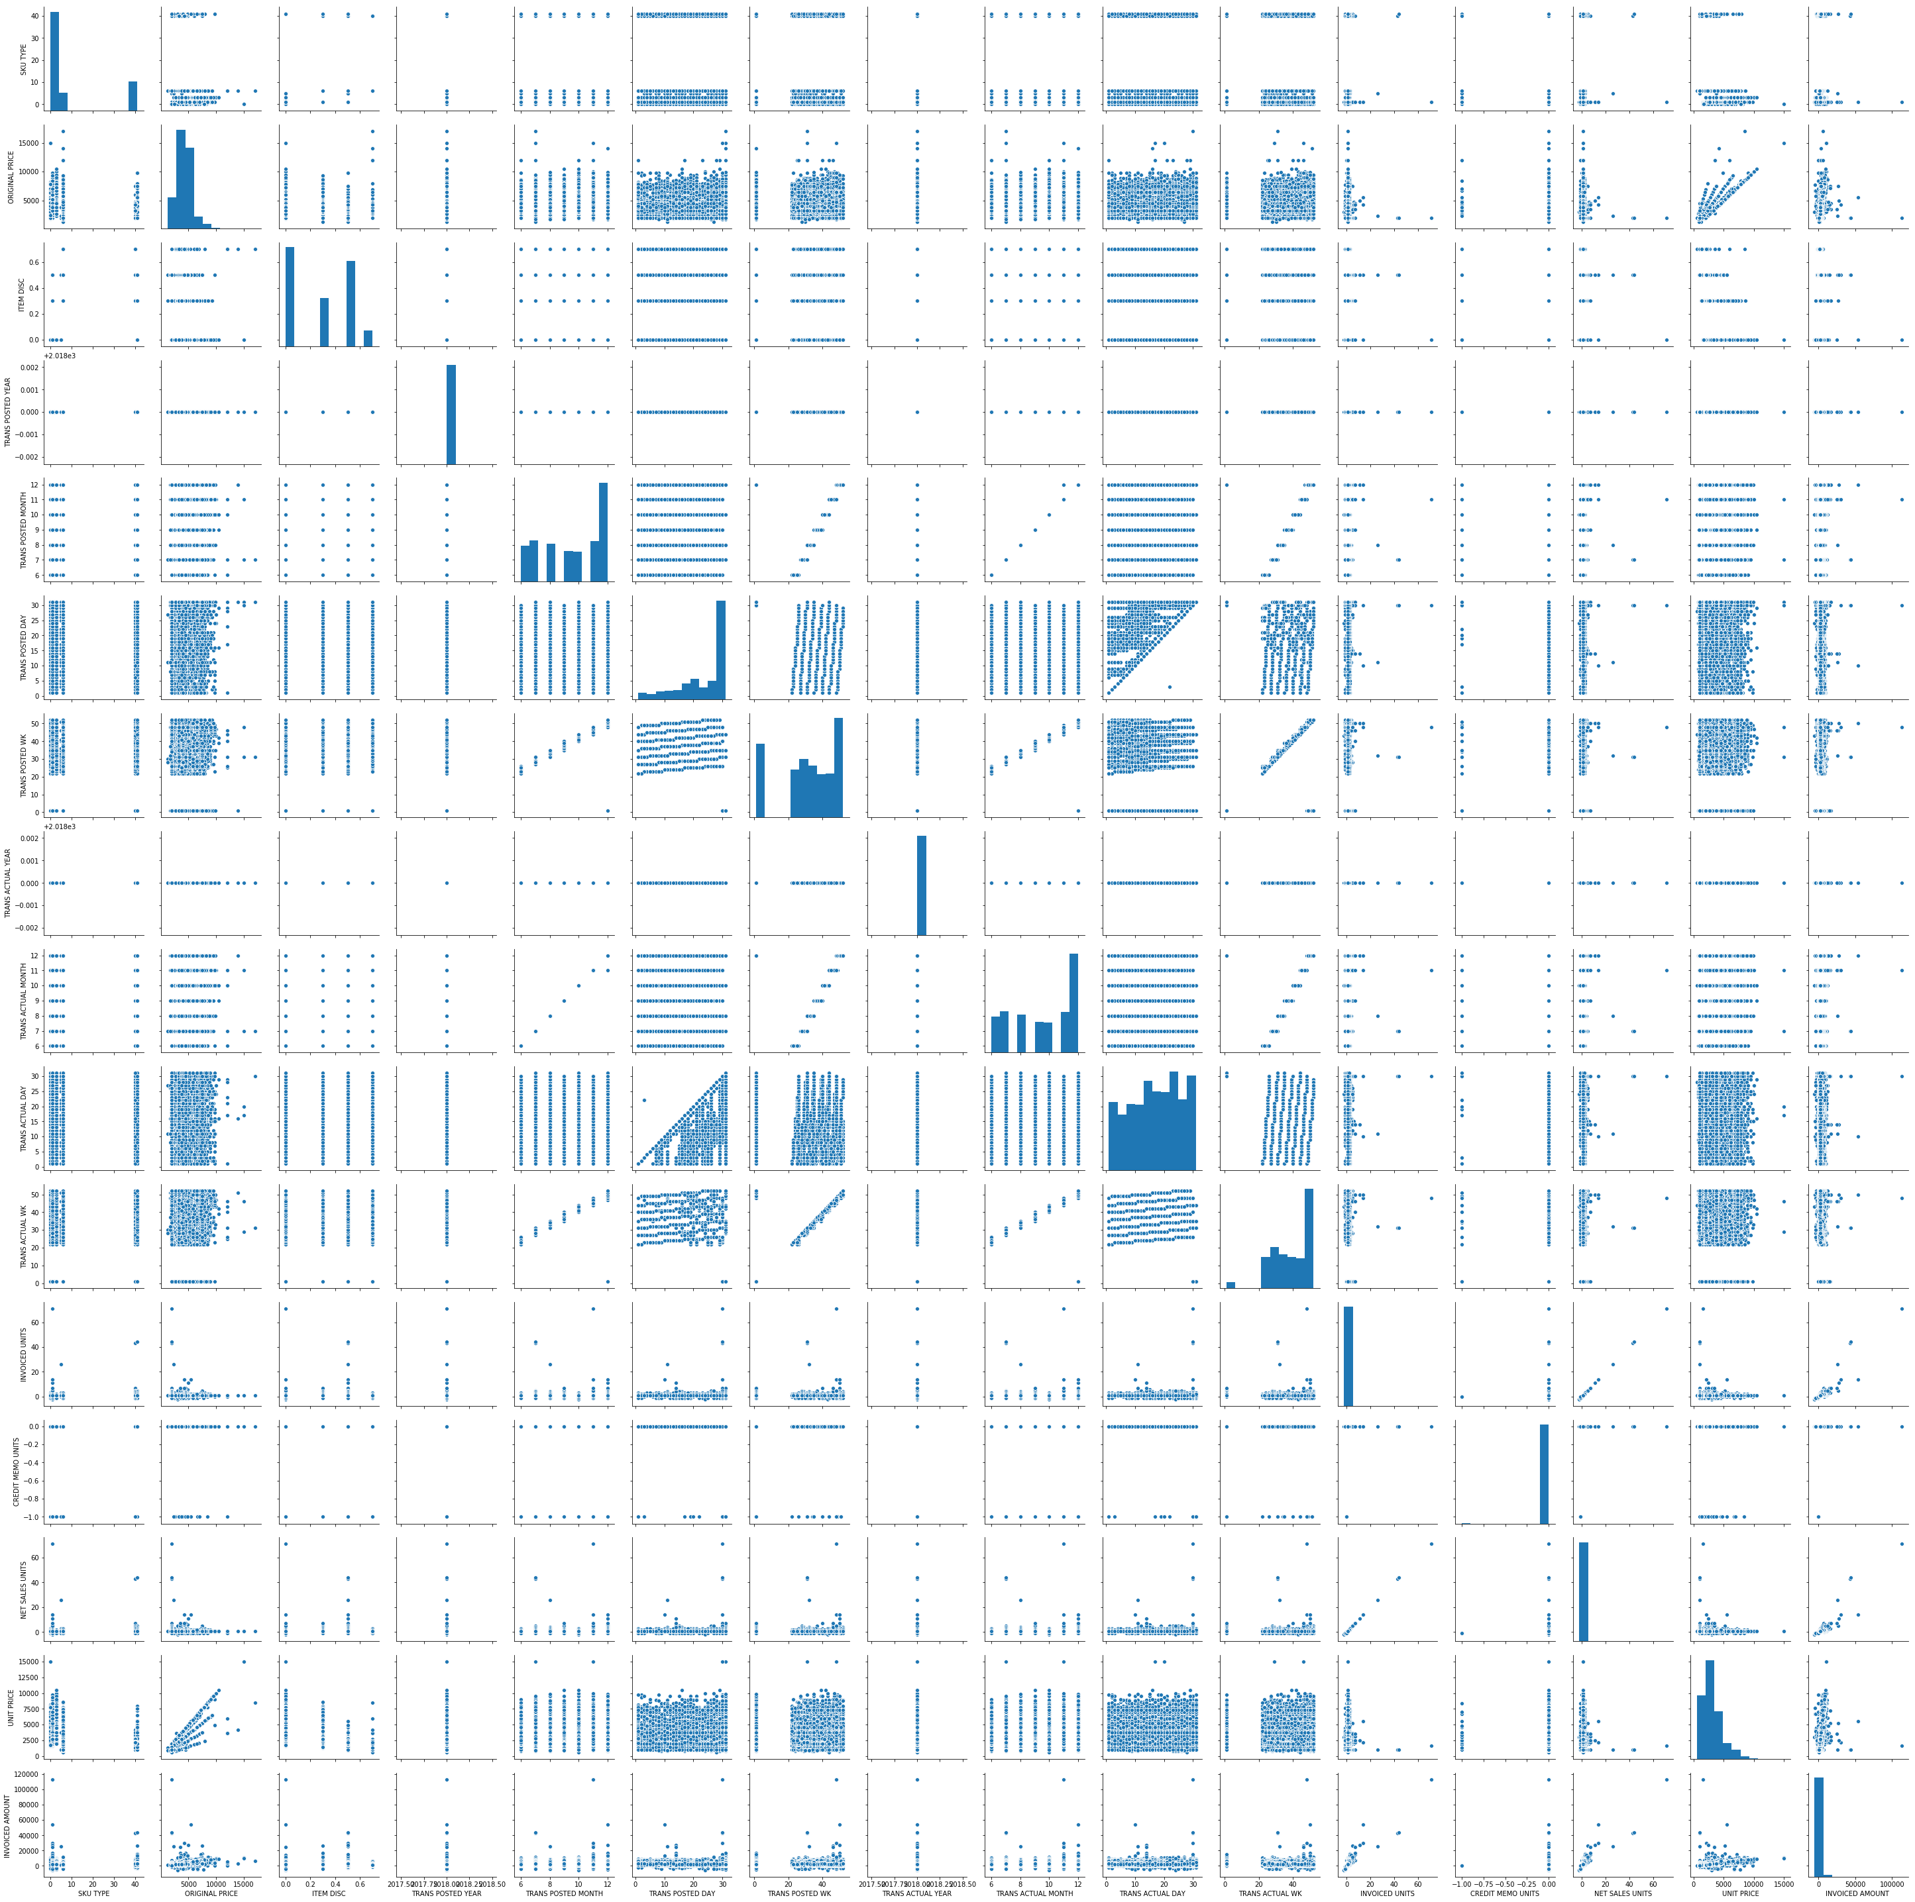

Slide 6
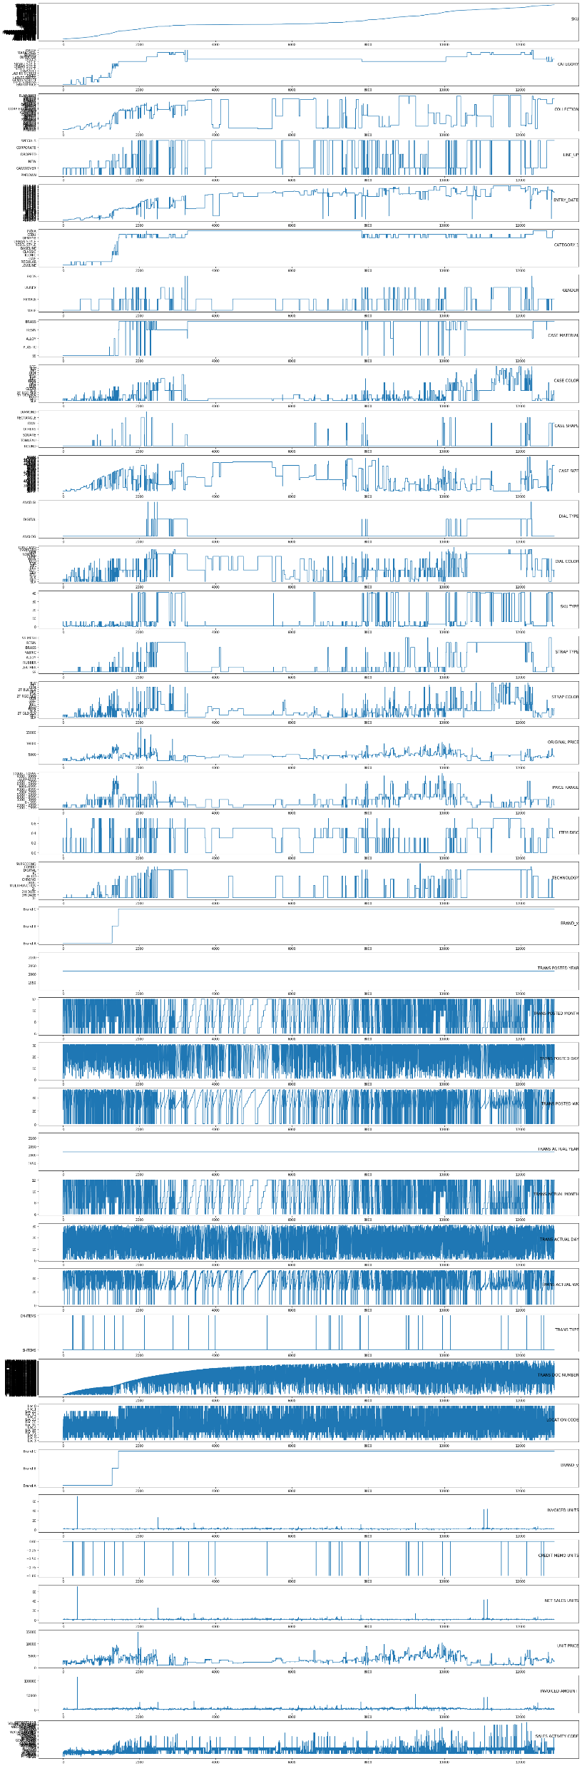
Subplot:-The Matplotlib subplot() function can be called to plot two or more plots in one figure. Matplotlib supports all kind of subplots including 2x1 vertical, 2x1 horizontal or a 2x2 grid. Related courses

Slide 7
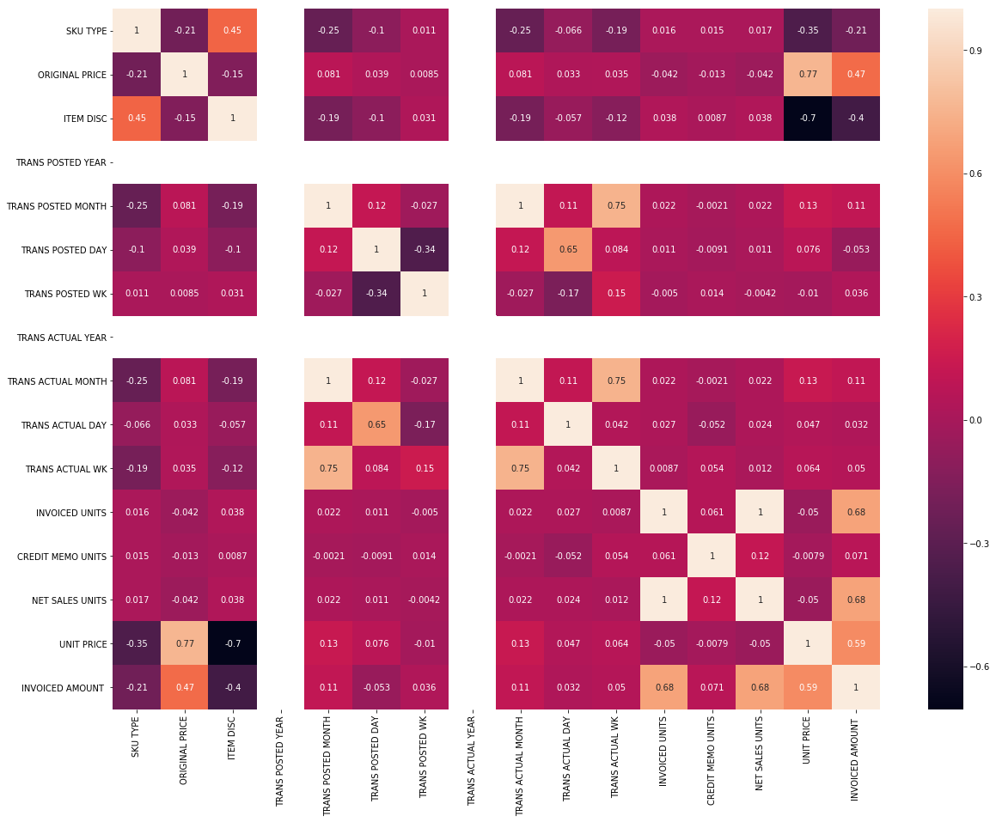
Heatmap:-Most of the coloumns here do not share any correlation as shown in earlier plots.

Slide 8
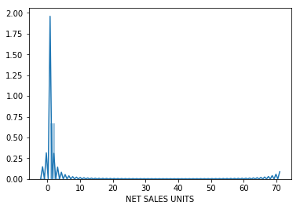

Density Plot
Has sharper peak at 0. Elongates to right.
Similar to Net Sales Units Graph.Has sharper peak at 0. Elongates to right.

Slide 9
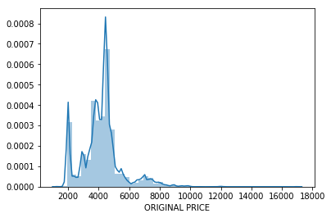
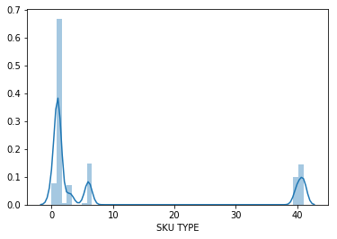
Has a sharper peak at 5000
Does not Peak at all . Highest value between 0-2

Slide 10
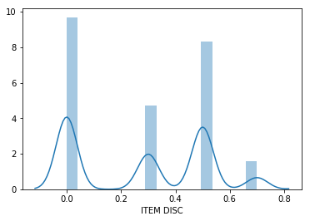
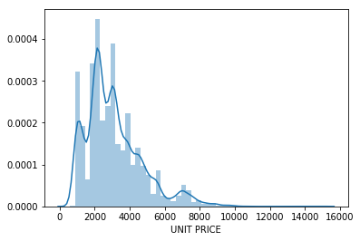
Linked normal curves from 0.0 to 0.5. 0.7 is outlier. 0.3 does not peak enough to be normal curve.
Resembles normal curve. Peaks around 2500. Elongates to Right

Slide 11
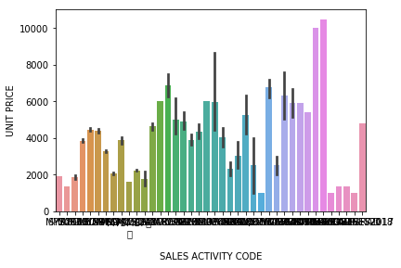
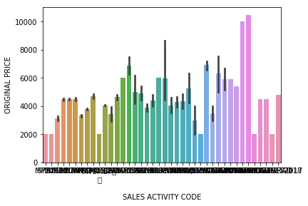
Barplot
Plot shows Sales Activity code at various Unit Price. Highest Unit Price 10000
Plot shows Sales Activity code at various original Price. Highest and Lowest Orignal Price are 10000 and 2000

Slide 12
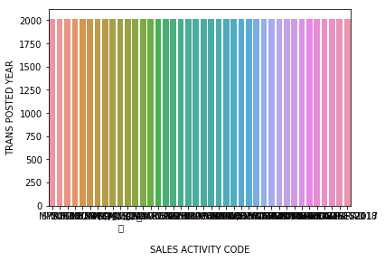
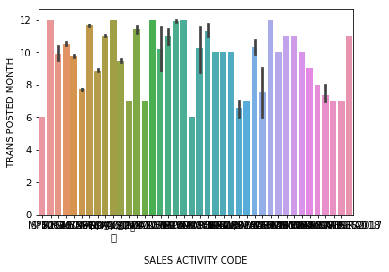
Plot shows Sales Activity code at various TRANS POSTED YEAR all having same values
Plot shows Sales Activity code at various TRANS POSTED MONTH

Slide 13
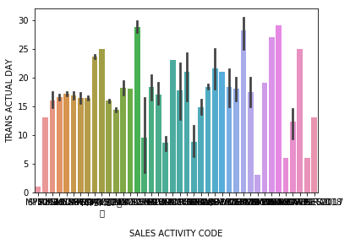

Plot shows Sales Activity code at various TRANS ACTUAL WK
Plot shows Sales Activity code at various TRANS ACTUAL DAY

Slide 14
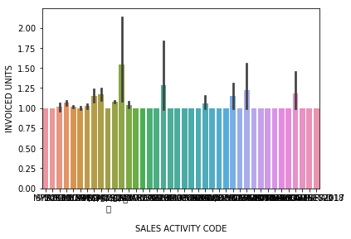
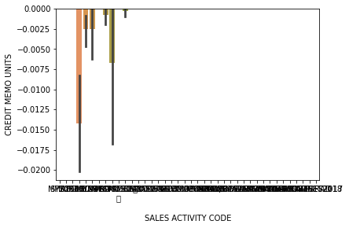
Plot shows Sales Activity code at various INVOICED UNITS
Plot shows Sales Activity code at various CREDIT MEMO UNITS

Slide 15
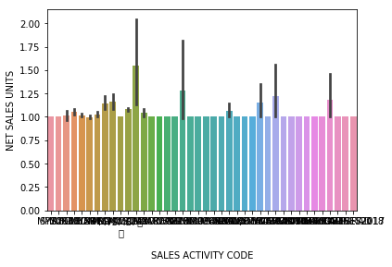
Plot shows Sales Activity code at various NET SALES UNITS

Slide 16
K Means Clustering
Step 1:- Initialize cluster centers
Step 2:- Assign observations to the closest cluster center(through Euclidean Distance)
Step 3:- Revise cluster centers as mean of assigned observations
Step 4: Repeat step 2 and step 3 until convergence
We have also find:-
Preprocessing using min max scaler
Elbow Plot (for value of K)

Slide 17
Thank You
Email Id:- Shukla.harshit1996@gmail.com
Contact no.:-8076282437

